Slide 1
Presentation-1 on Chosen Advanced ML Technique –EfficientDet Advanced Machine Learning ITI41820

Slide 2
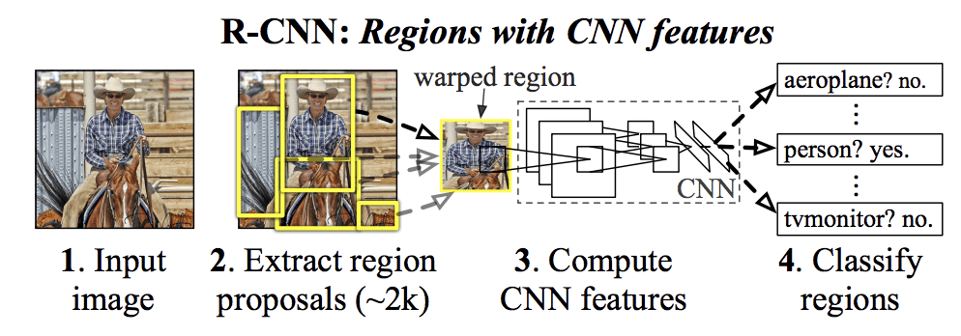
What is Object Detection? Simply put – Classification and Localisation!
For any object detection task
Object Proposals
Classification
Localisation

Slide 3
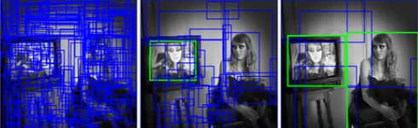
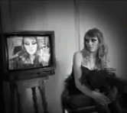
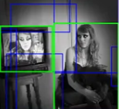
1. What is this technique / algorithm?
Chosen Technique / Algorithm : One-Stage Object Detection using EfficientDet algorithm.
TSOD
TSOD | OSOD
RCNN | YOLO
Fast RCNN | SSD
Faster RCNN | EfficientDet
OSOD

Slide 4
2. Why EfficientDet special?
Cost effective (Less parameters than other YOLO)
YOLO 61M
Faster RCNN 57M
SSD 25M
EfficientDet 5.3M
Balances the speed vs accuracy tradeoff
Adaptive Transfer Learning

Slide 5
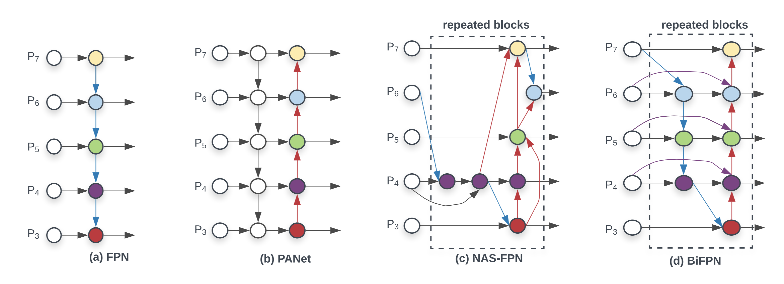
3.1 How is it different from other similar techniques
BiFPN - Bilateral Fusion Pyramid Network
Used in EfficientDet
Used in YOLOv5
(top down+bottom up)
(top down+
bottom up+
skip Connections)
Used in SSD (top down)

Slide 6
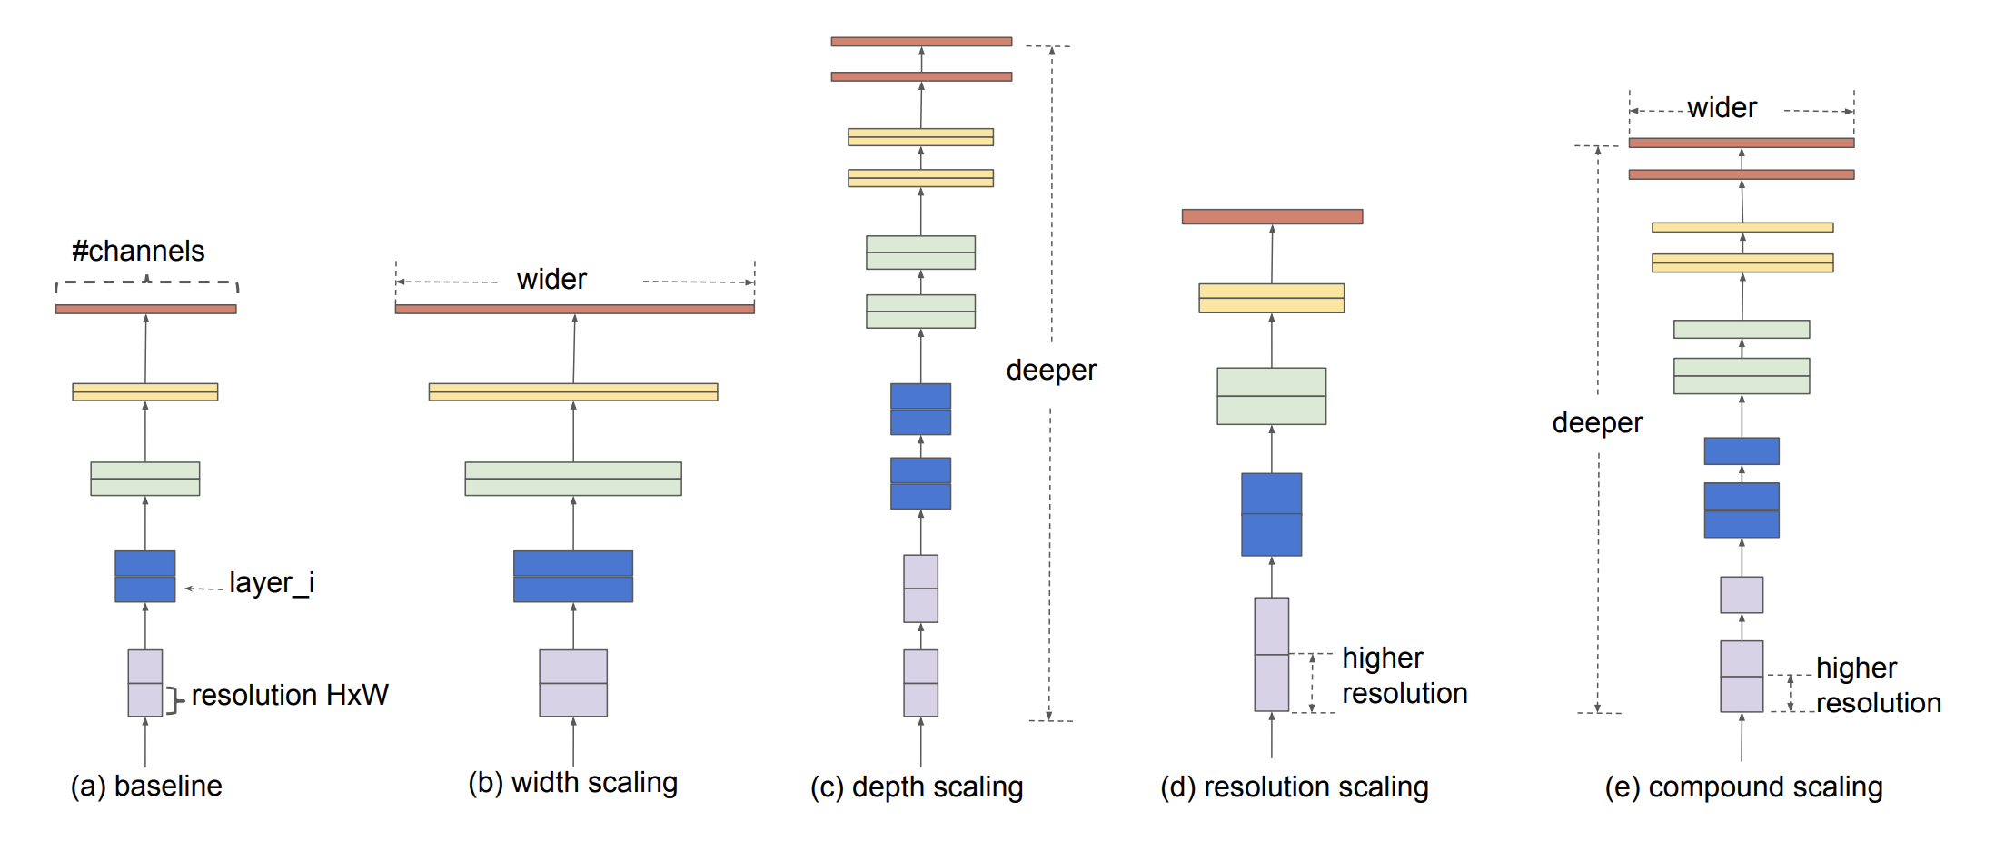
3.2 How is it different from other similar techniques
Compound Scaling method for Uniform Scaling
Tan, M., & Le, Q. (2019, May). Efficientnet: Rethinking model scaling for convolutional neural networks. In International conference on machine learning (pp. 6105-6114). PMLR.
+
=

Slide 7
3.3 Practical Example
Widely used in real time edge computing with high time constraints
EfficientDet for fabric defect detection based on edge computing (2021, S. Song et al)
EfficientDet for Crop Circle Detection in Desert (M.L.Mekhalfi et al 2022)

Slide 8
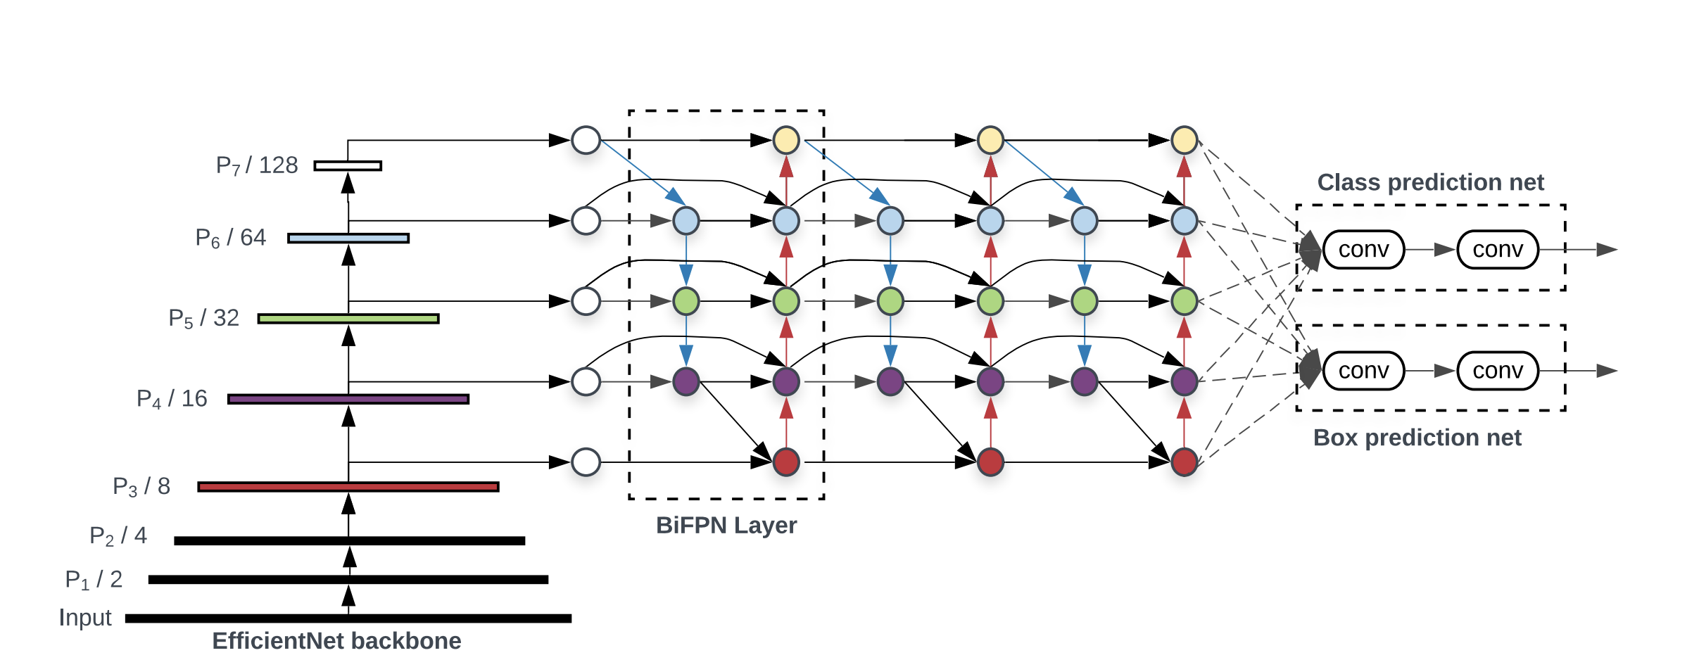
4.1 Working Principle
EfficientDet Architecture
Tan, M., Pang, R., & Le, Q. V. (2020). Efficientdet: Scalable and efficient object detection. In Proceedings of the IEEE/CVF conference on computer vision and pattern recognition (pp. 10781-10790).
Backbone
Head
Neck

Slide 9
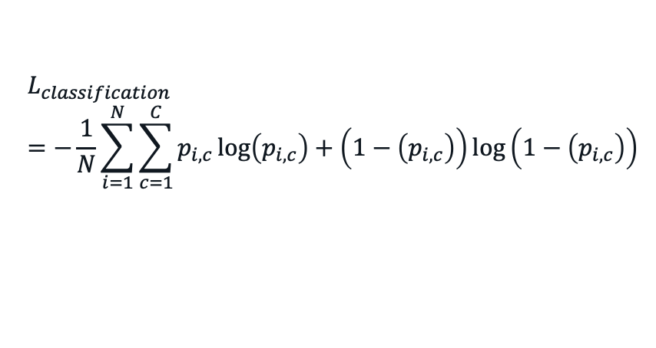
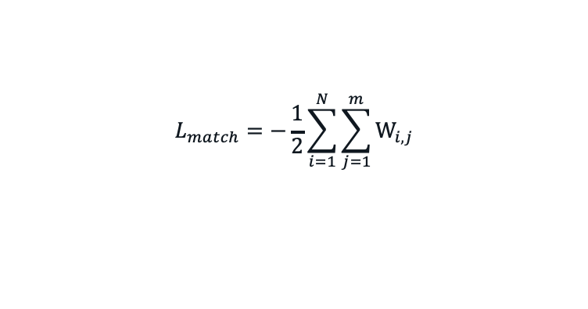
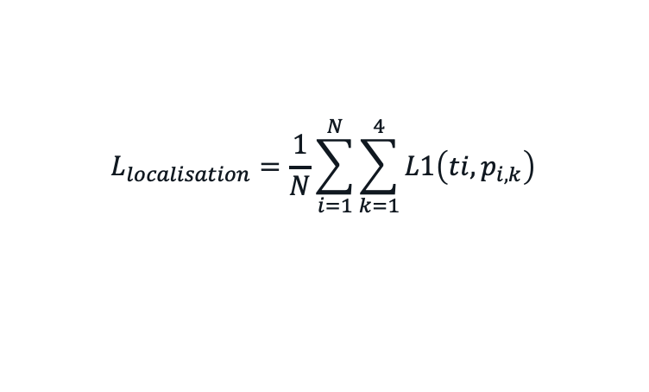
4.2 Working Principle
Loss Functions
Classification Loss
Localisation Loss
Anchor Matching Loss / Regularisation
$$L_{classification}=−\frac{1}{N}\sum_{i=1}^{N}{\sum_{c=1}^{C}{p_{i,c}\log\left(p_{i,c}\right)+\left(1−\left(p_{i,c}\right)\right)log\left(1−\left(p_{i,c}\right)\right)⁡}}$$
$$L_{localisation}=\frac{1}{N}\sum_{i=1}^{N}{\sum_{k=1}^{4}{L1\left(ti,p_{i,k}\right)}}$$
$$L_{match}=−\frac{1}{2}\sum_{i=1}^{N}{\sum_{j=1}^{m}{W_{i,j}}}$$

Slide 10
5. Advantages and Disadvantages
Advantages
Super efficient and Accurate among other OSOD
Less number of parameters compared to other OSOD
Simple Architecture
Disadvantages
Large memory requirement
Train time
Lack of Interpretability

Slide 11
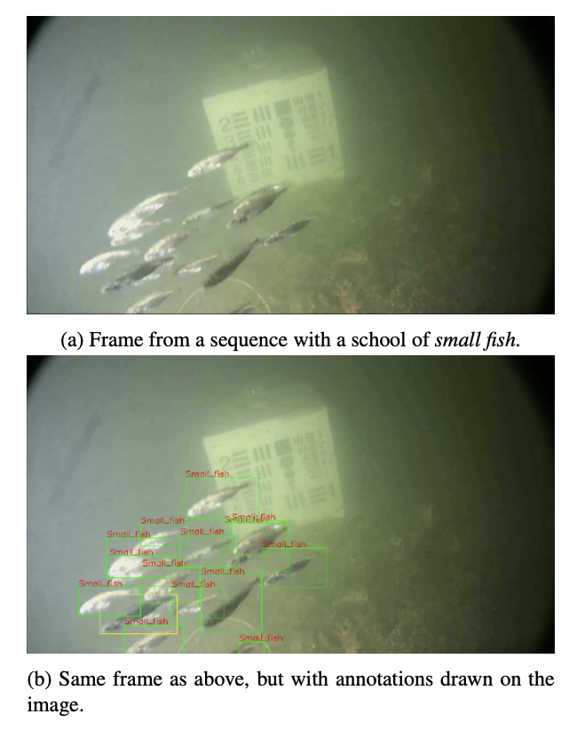
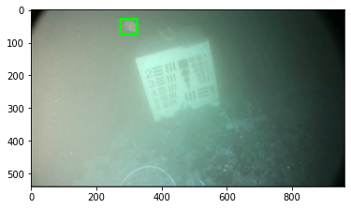
6.1 Probable Practical Application
Detection of underwater martime objects (Brackish Dataset AALBORG University) – Cross Domain Modalities
Source of Dataset: Pedersen, M., Bruslund Haurum, J., Gade, R., & Moeslund, T. B. (2019). Detection of marine animals in a new underwater dataset with varying visibility. In Proceedings of the IEEE/CVF Conference on Computer Vision and Pattern Recognition Workshops (pp. 18-26).

Slide 12
6.2 Why EfficientDet for this application than other OSOD like YOLO, SSD, RetinaNet
EfficientDet has reportedly proven to work best on
Complex task domains where objects are relatively difficult to identify because of the nature of task.
For example – Crop Detection, Adulteration detection in grains, Defect detection in fabric factory, Efficient site detection for solar power etc.
Most of the researchers has considered YOLO framework because of its fast-to-implement, however, for such complex tasks, EfficientDet is expected to give SOTA accuracy on such tasks. One of such tasks, that I plan to chose is “Detection of underwater martime objects”

Slide 13
Planned Novel Contributions
Replacing backbone for specific task
EfficientDet has less interpretability.
To make it more Interpretable.
Make it robust for adversarial attacks, by adversarial training.

Slide 14

Thank You! Questions? References:
[1] Girshick, R., Donahue, J., Darrell, T., & Malik, J. (2014). Rich feature hierarchies for accurate object detection and semantic segmentation. In Proceedings of the IEEE conference on computer vision and pattern recognition (pp. 580-587).
[2] Tan, M., Pang, R., & Le, Q. V. (2020). Efficientdet: Scalable and efficient object detection. In Proceedings of the IEEE/CVF conference on computer vision and pattern recognition (pp. 10781-10790).

Slide 15
Probable Question
But Why I would use EfficientDet? I have been able to solve my tasks with YOLO very well so far. Is it worth to re-establish my whole ML infrastructure and replace YOLO with EfficientDet? Will it be really rewarding?

Slide 16
Presentation-2 Detection and Classification of Maritime objects using EfficientDet Advanced Machine Learning ITI41820

Slide 17
Part A…

Slide 18
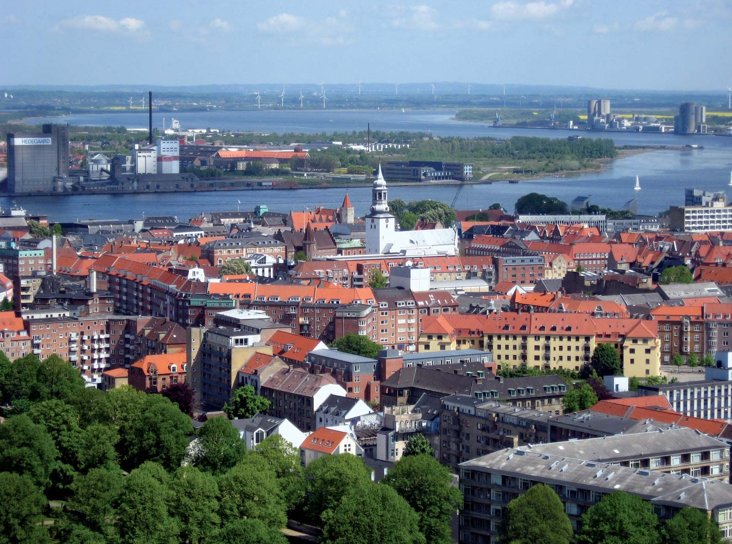

Part A.1: What is the selected application?
Limfjorden – Brackish Strait
Marine Species Detection and Localization
To an extent, when trained models are deployed into the wild, application becomes: “Automated Maritime Object Detection and Marine Vision - AMODMV”
Dataset - First publicly available European underwater image dataset
Recorded in Limfjorden, which is a brackish strait that runs through Aalborg in the northern part of Denmark
Fish,Small_fish,Crab,Shrimp,Jellyfish,Starfish (Total 6 classes)
https://vap.aau.dk/the-brackish-dataset/

Slide 19
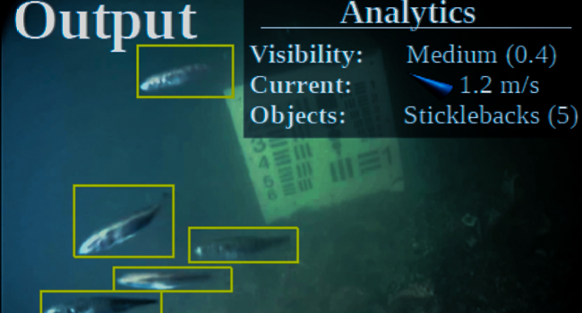
Part A.2: What are the challenges related to the application?
Marine Vision expeditions and discovery is expensive.
Variations in illumination
Angle of the captured image
Complexity of the marine environment
Quality and Quantity of available Datasets
Noise
(The particles found in water images, ranging from dissolved matter to floating leaves and seaweed, are considered )

Slide 20
Part A.3.1: Why Object Detection suitable to handle the application
Automating Marine Vision
Automating the process of identifying and localizing marine animals in underwater images
Model can easily be trained to recognize, specific features of marine animals, such as their shape, color, and texture, and locate them within an image. Moreover, a specie too.
Save time and cost in analyzing and research aquatic life.
Marine life ecology, behavior and diversity where humans cannot reach.

Slide 21
Part A.3.2: Why EfficientDet Object Detection suitable to handle the application
Cheap computation (Efficient)
Less number of parameters to deploy on edge 24 Megabytes
State of the art (High Accuracy)
We will see results and analysis in Part C of the presentation
Well suited to domains like:
EfficientDet can handle challenging conditions such as variations in illumination and the presence of noise from particles in the water
This is because of the architecture (we saw in Presentation 1)

Slide 22
Part A.4: What other alternative techniques / algorithm can be applied to handle this application?
Newly! applied techniques (in this project):
EfficientDet d0 (for best results)
YOLOv8 (for comparisons)
YOLOv5 (for comparisons)
Detectron2 (for comparisons)
Previously applied techniques:
CNN (fine tuned)
YOLOv3
YOLOv4
We analyze comparative analysis in detail in part C

Slide 23
Part A.5: Why do you think your selected technique / algorithm is better than alternatives?
BiFPN - Bilateral Fusion Pyramid Network
EfficientNet backbone
Robustness (changing environment and domains)
Multi Task Learning – Object Detection + Classification (3 losses – localization loss, classification loss and regularization loss)
localization loss
classification loss
regularization loss

Slide 24
Part B…

Slide 25
Part B.1: What are your selected articles?
[1]. Xu, S., Zhang, H., He, X., Cao, X., & Hu, J. (2022). Oil tank detection with improved EfficientDet model. IEEE Geoscience and Remote Sensing Letters, 19, 1-5.
Oil Tank Detection With Improved EfficientDet Model Su Xu; Haowei Zhang; Xiping He; Xiaoli Cao; Jian Hu IEEE Geoscience and Remote Sensing Letters Year: 2022 | Volume: 19 | Journal Article | Publisher: IEEE
[2]. Mekhalfi, M. L., Nicolò, C., Bazi, Y., Al Rahhal, M. M., Alsharif, N. A., & Al Maghayreh, E. (2021). Contrasting YOLOv5, transformer, and EfficientDet detectors for crop circle detection in desert. IEEE Geoscience and Remote Sensing Letters, 19, 1-5.
Contrasting YOLOv5, Transformer, and EfficientDet Detectors for Crop Circle Detection in Desert Mohamed Lamine Mekhalfi; Carlo Nicolò; Yakoub Bazi; Mohamad Mahmoud Al Rahhal; Norah A. Alsharif; Eslam Al Maghayreh IEEE Geoscience and Remote Sensing Letters Year: 2022 | Volume: 19 | Journal Article | Publisher: IEEE
[3]. Medak, D., Posilović, L., Subašić, M., Budimir, M., & Lončarić, S. (2021). Automated defect detection from ultrasonic images using deep learning. IEEE Transactions on Ultrasonics, Ferroelectrics, and Frequency Control, 68(10), 3126-3134.
Automated Defect Detection From Ultrasonic Images Using Deep Learning Duje Medak; Luka Posilović; Marko Subašić; Marko Budimir; Sven Lončarić IEEE Transactions on Ultrasonics, Ferroelectrics, and Frequency Control Year: 2021 | Volume: 68, Issue: 10 | Journal Article | Publisher: IEEE
[4]. Qin, P., Cai, Y., Liu, J., Fan, P., & Sun, M. (2021). Multilayer feature extraction network for military ship detection from high-resolution optical remote sensing images. IEEE Journal of Selected Topics in Applied Earth Observations and Remote Sensing, 14, 11058-11069.
Multilayer Feature Extraction Network for Military Ship Detection From High-Resolution Optical Remote Sensing Images Peng Qin; Yulin Cai; Jia Liu; Puran Fan; Menghao Sun IEEE Journal of Selected Topics in Applied Earth Observations and Remote Sensing Year: 2021 | Volume: 14 | Journal Article | Publisher: IEEE
[5]. Kim, H. J., Lee, D. H., Niaz, A., Kim, C. Y., Memon, A. A., & Choi, K. N. (2021). Multiple-clothing detection and fashion landmark estimation using a single-stage detector. IEEE Access, 9, 11694-11704.
Multiple-Clothing Detection and Fashion Landmark Estimation Using a Single-Stage Detector Hyo Jin Kim; Doo Hee Lee; Asim Niaz; Chan Yong Kim; Asif Aziz Memon; Kwang Nam Choi IEEE Access Year: 2021 | Volume: 9 | Journal Article | Publisher: IEEE

Slide 26
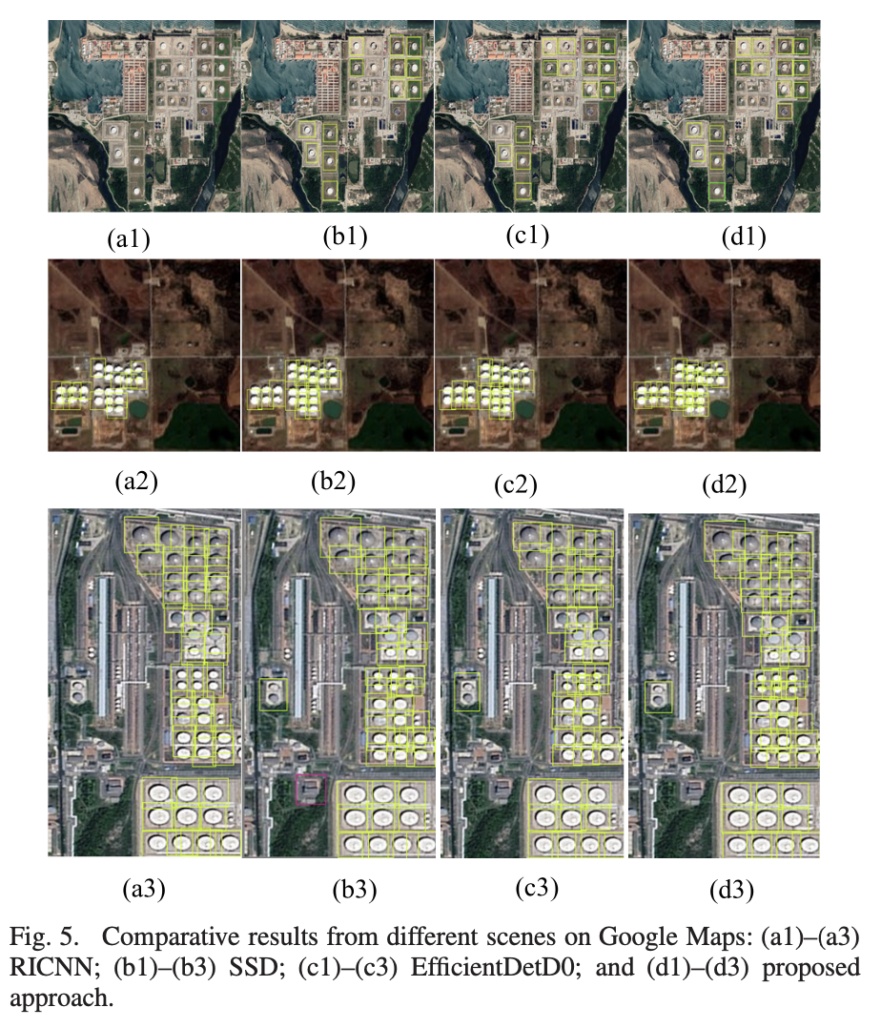
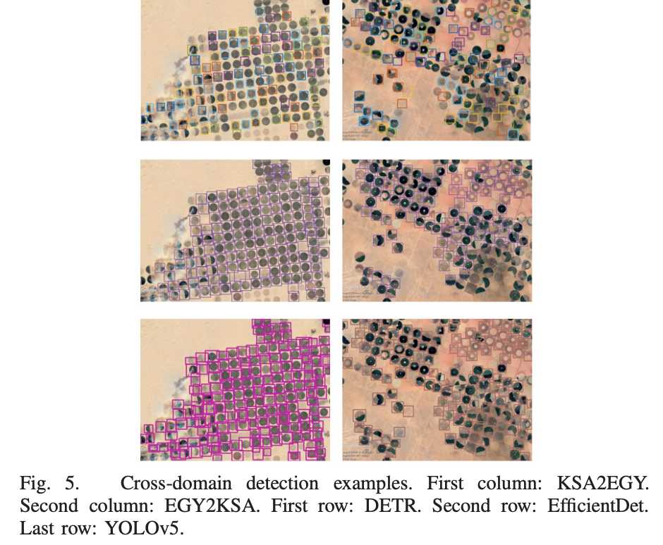
Part B.2: Why do you think your selected articles are related to your work?
Xu et al. (2022) [1] uses an improved version of the EfficientDet model for detecting oil tanks, which could potentially be adapted for detecting other types of objects in marine environments.
Mekhalfi et al. (2022) [2] compares different object detection models for detecting crop circles in desert regions, but the techniques and algorithms used in these models could also be applied to detecting other types of objects or features in marine environments.

Slide 27
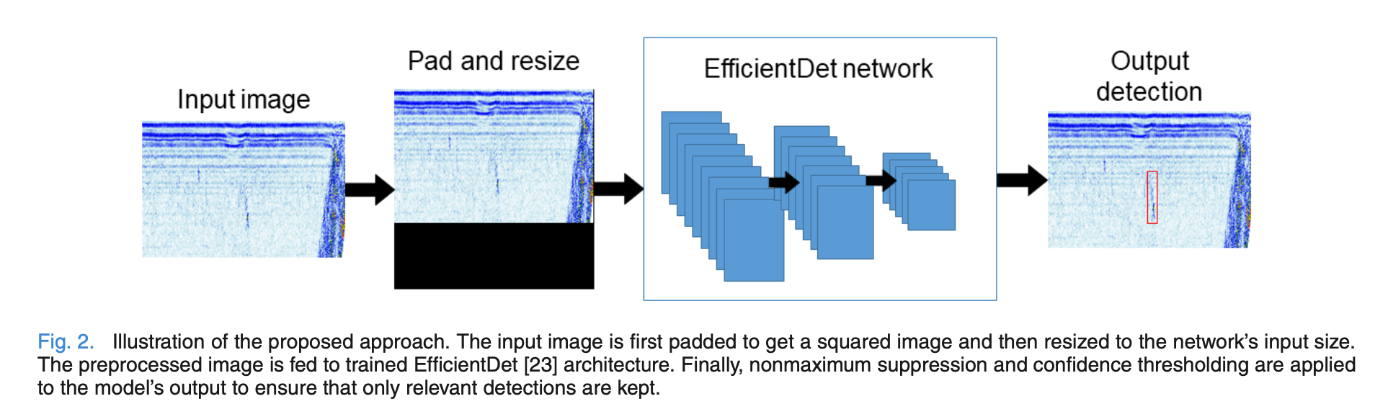
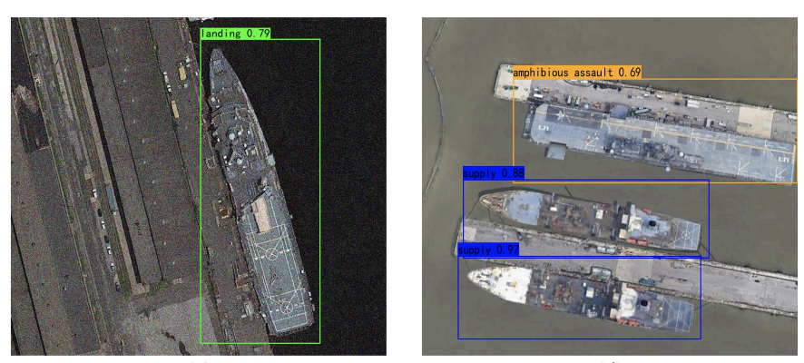
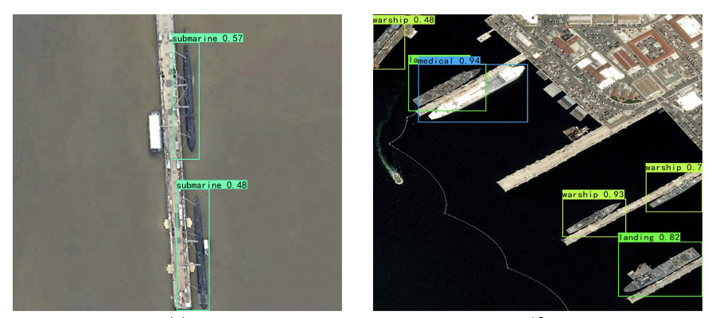
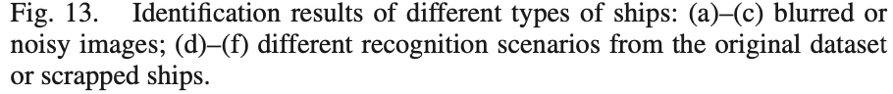
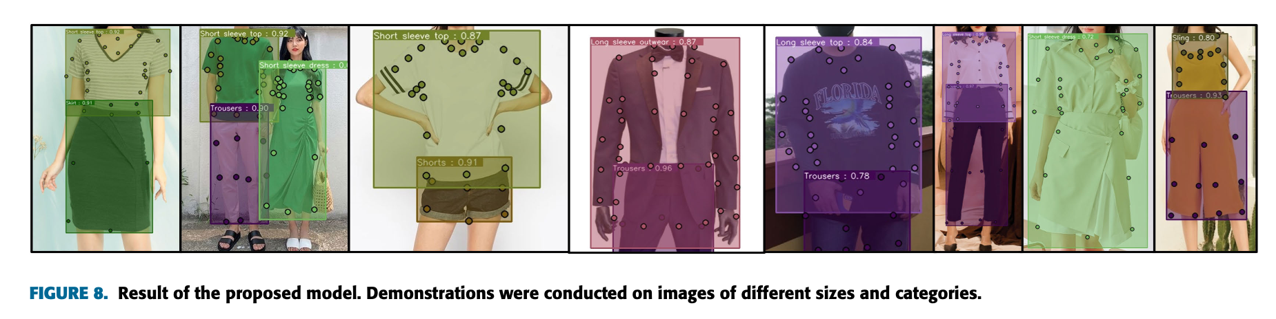
Part B.2: Why do you think your selected articles are related to your work?
Medak et al. (2021) [3] uses OD for defect detection in ultrasonic images, which could potentially be applied to detecting defects, abnormalities or noise in underwater images of marine life or structures.
Qin et al. (2021) [4] While the focus of this article is on detecting military ships, the same techniques and methods used in this study could potentially be applied to detecting other types of marine vessels or even marine life in remote sensing images
Kim et al. (2021) [5] uses a effdet detector for detecting multiple items of clothing, which could potentially be adapted for detecting and tracking multiple marine organisms in underwater images.

Slide 28
Part B.3 Goal, Methodology, Results, Advantages and Disadvantages
# | Goals | Methodology | Results | Advantages | Disadvantages
1 | Oil tank detection using remote sensing imagery [1] | Modification of the model Training EffDet | Higher accuracy and less inference time (100mAP) | Suitable for IoT based Obj Detection | Suitable for remote sensing, not marine vision
2 | Compare OD models for crop circle detection in desert [2] | Annotated dataset to train YOLO and Efficient Det | EfficientDet achieves higher accuracy than other models (91mAP) | Useful comparison based on feature extraction layers of different OD models | Overfitting, Complexity, Memory requirements, difficult to fine tune for specific task.
3 | Defect detection in ultrasonic images [3] | Using bi-level CNN and vanilla NN for task | Beats SOTA with high accuracy (89.65mAP) | Cheap localization, simple regression loss | Not uses any standard object detection baseline
4 | Detecting military ships in high-resolution optical remote sensing images [4] | Using pretrained backbone, FPN layer for feature extraction (at different scales) and regular NN for class loss for annotated dataset. | EfficientDet achieves higher accuracy in remote sensing imagery (97.05mAP) | The technique and application has potential to extend to underwater marine vision | The model still uses old FPN layer which is prone to catastrophic forgetting, and label dispersion
5 | Clothing Dataset [5] | Using SSOD for annotated clothing dataset | Finds fashion landmark (apparel factor) in the clothing (68.60mAP*) | Uses curriculum learning, along with SSOD, better generalization | Take 4 times more time to train and could lead to large parameter size ~B

Slide 29
Part C…

Slide 30
Part C.1.1
The idea is to use a robust model for extracting low-level class specific features using Multi-Task Learning to detect and recognize marine life using “Aalborg Brackish Dataset”
In this project, I propose using EfficientDet algorithm for object detection in brackish water aquaculture and comparing its performance with YOLO, Faster RCNN and Detectron2
The aim is to improve the efficiency and sustainability of the aquaculture industry by monitoring fish behavior and growth accurately in the murky water conditions.
"EfficientDet for Object Detection in Brackish Water Aquaculture"

Slide 31
Part C.1.2: The Platform (AWS Sagemaker) + Conf
Configuration Name | Value
Environment | Linux (Ubuntu-Like)
Service Provider | Amazon AWS (EC2)
Instance Family | p3dn
vCPU | 96
Memory | 76 GiB
Cost (per hour) | 31.2 USD
GPU | NVIDIA V100 TensorCore
Hyperparameter | Value (YOLOv5)
Epochs | 350
Classes | 6
Backbone | CSP Darknet 53
Bottleneck | PANet
Head | Yolov3 like
Train Data | 7000
Val Data | 2000
Test Data | 1000
Annotation/Mask format | YOLO TXT
Optimizer | SGD
Learning rate | 0.1
Weight Decay (prevent overfit) | 0.0005 (Default)
Activation | Leaky ReLU
Value (EffDet)
350
6
EfficientNet
BiFPN
Yolov3 like
7000
2000
1000
COCO JSON
SGD + Adam
Adaptive
0.0005 (Default)
Leaky ReLU
Value (DT2)
350
6
ResNet
FPN
RPN+RCNN
7000
2000
1000
COCO JSON
SGD + Adam
Adaptive
0.0005 (Default)
Sigmoid (Bbox) + Softmax (Class)
As Detectron2 is a TSOD, it has a RPN as well for region proposal network

Slide 32
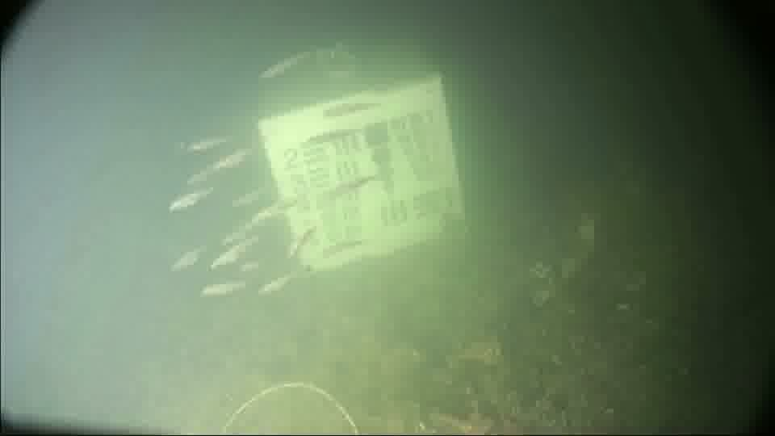
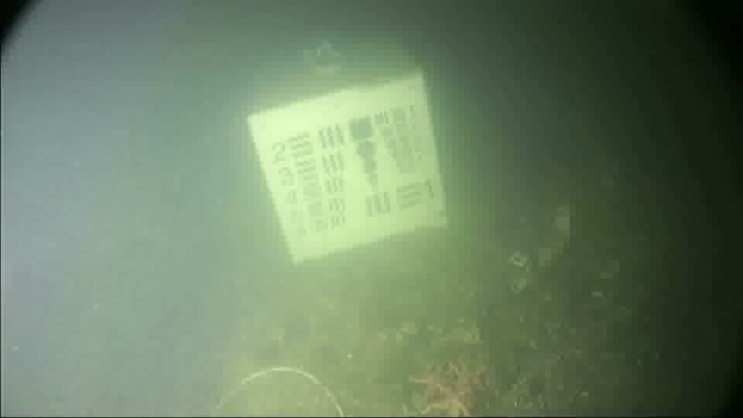
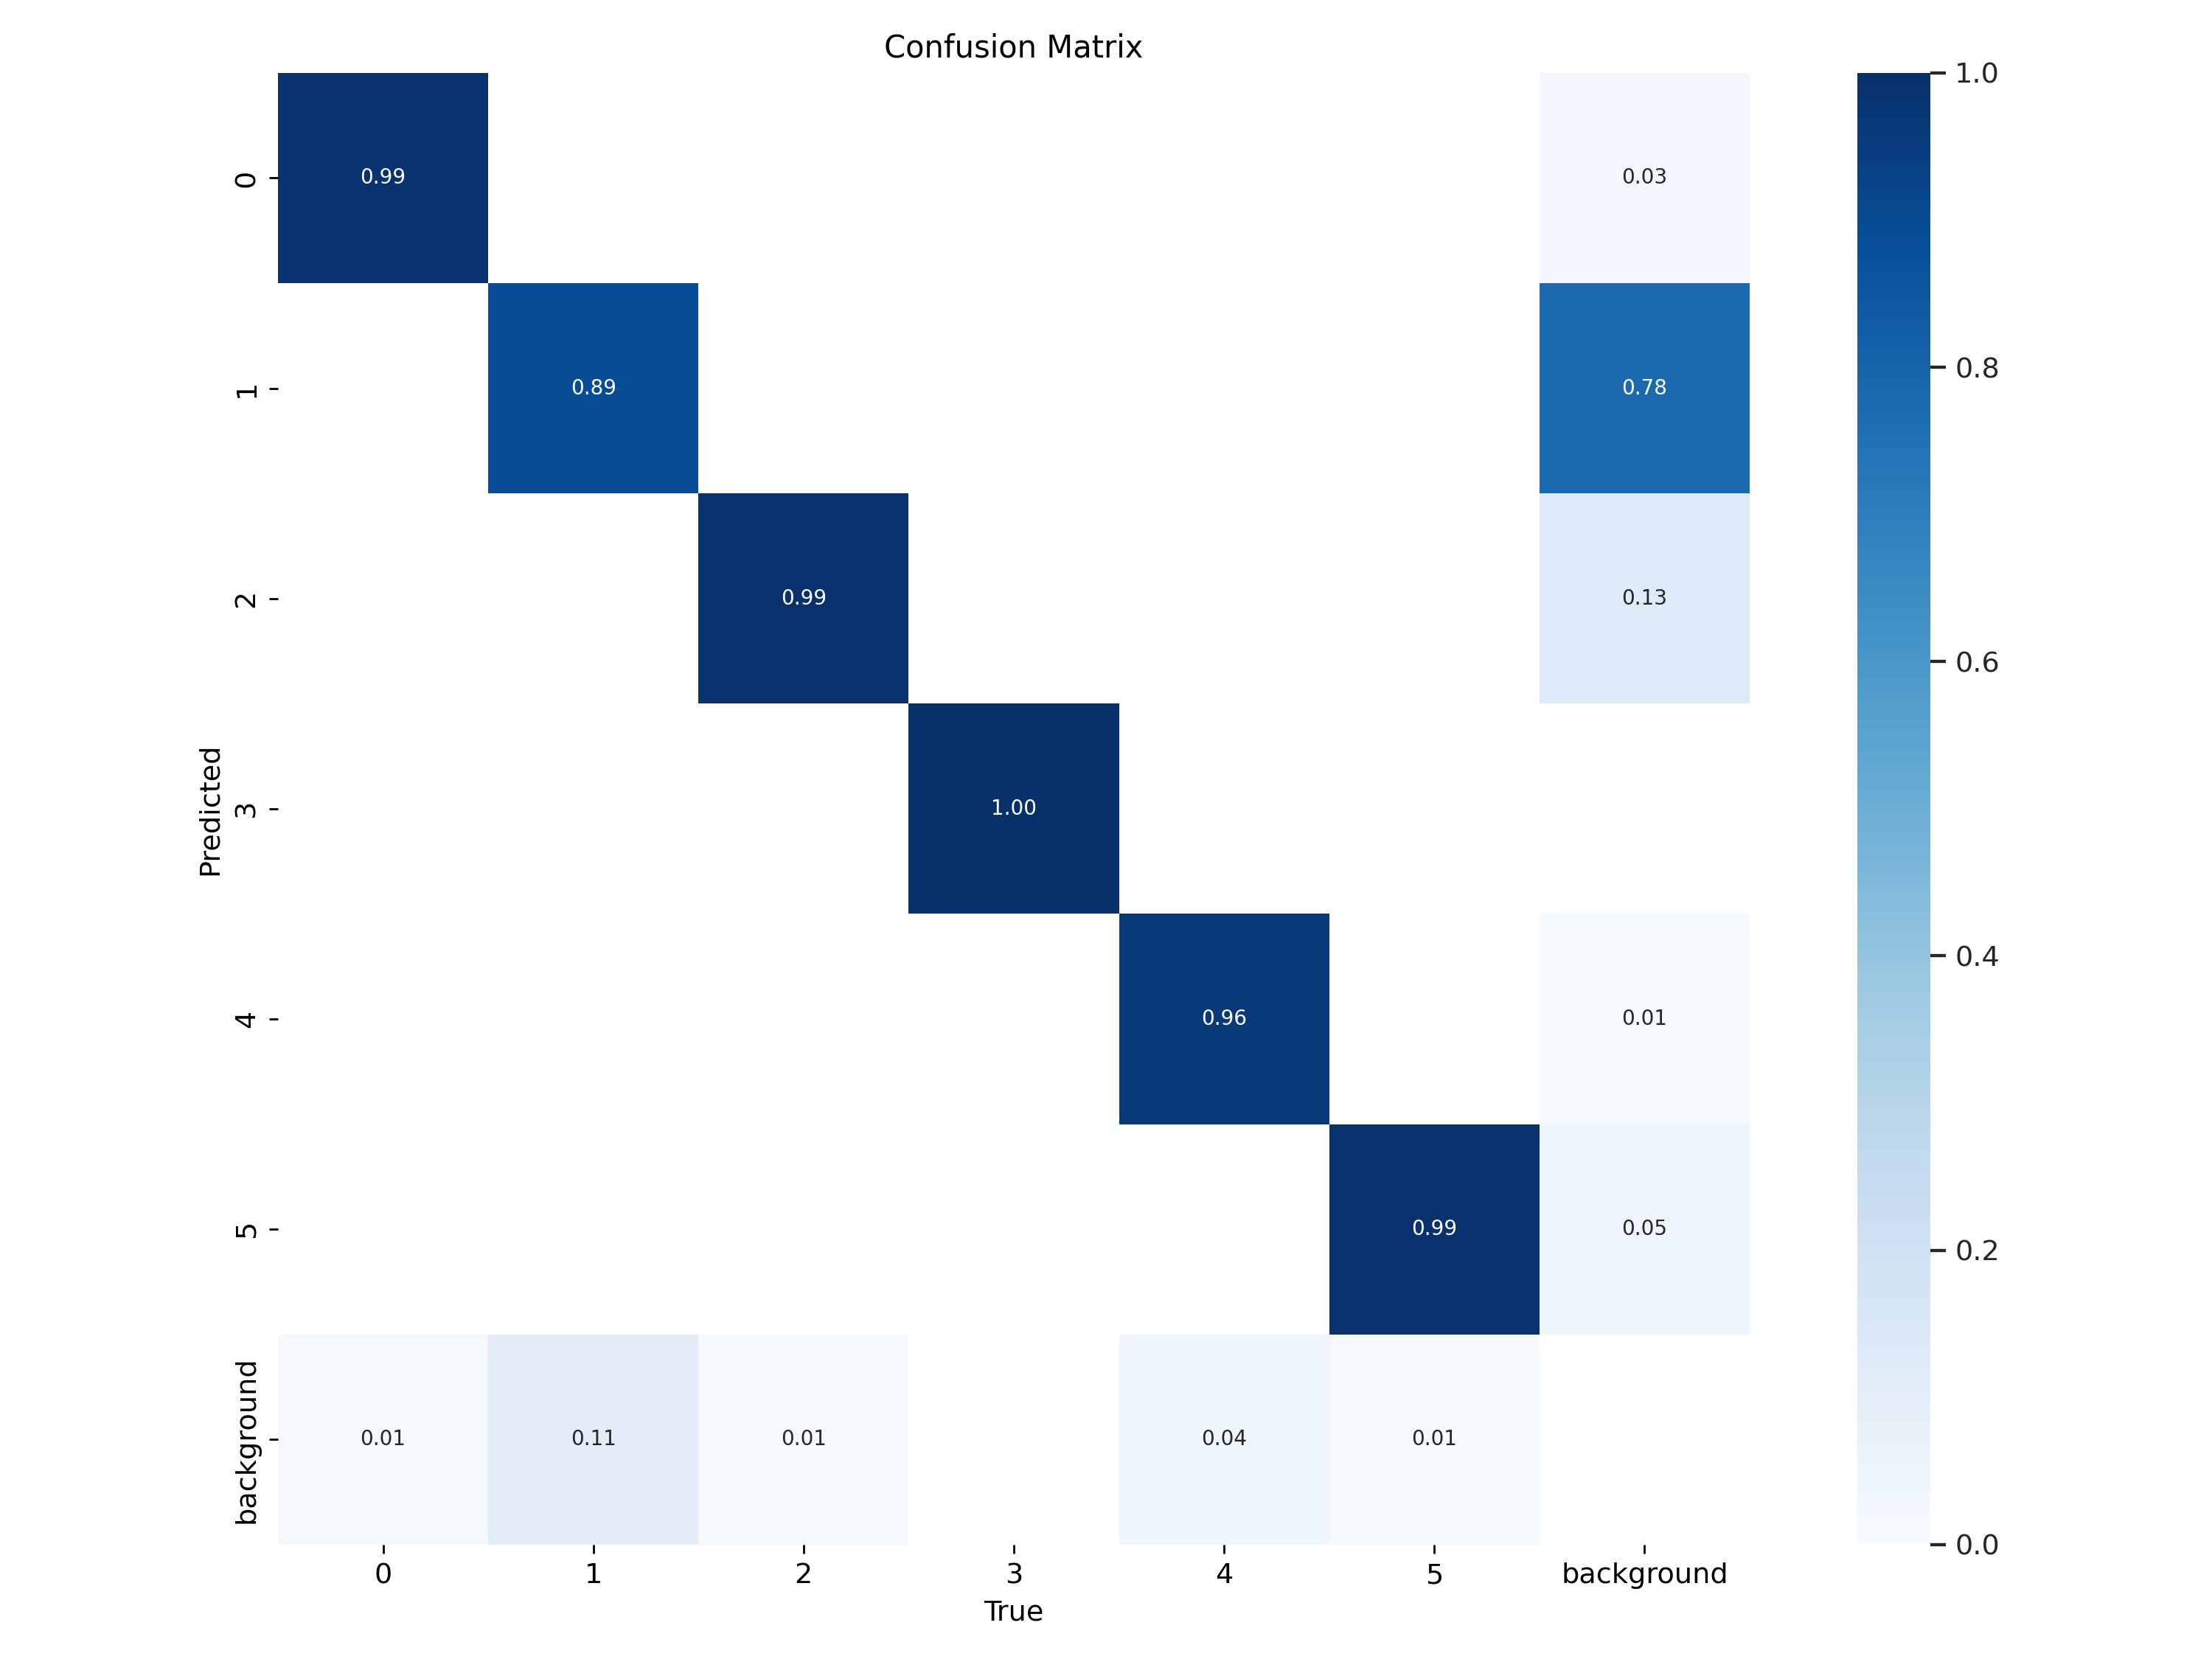
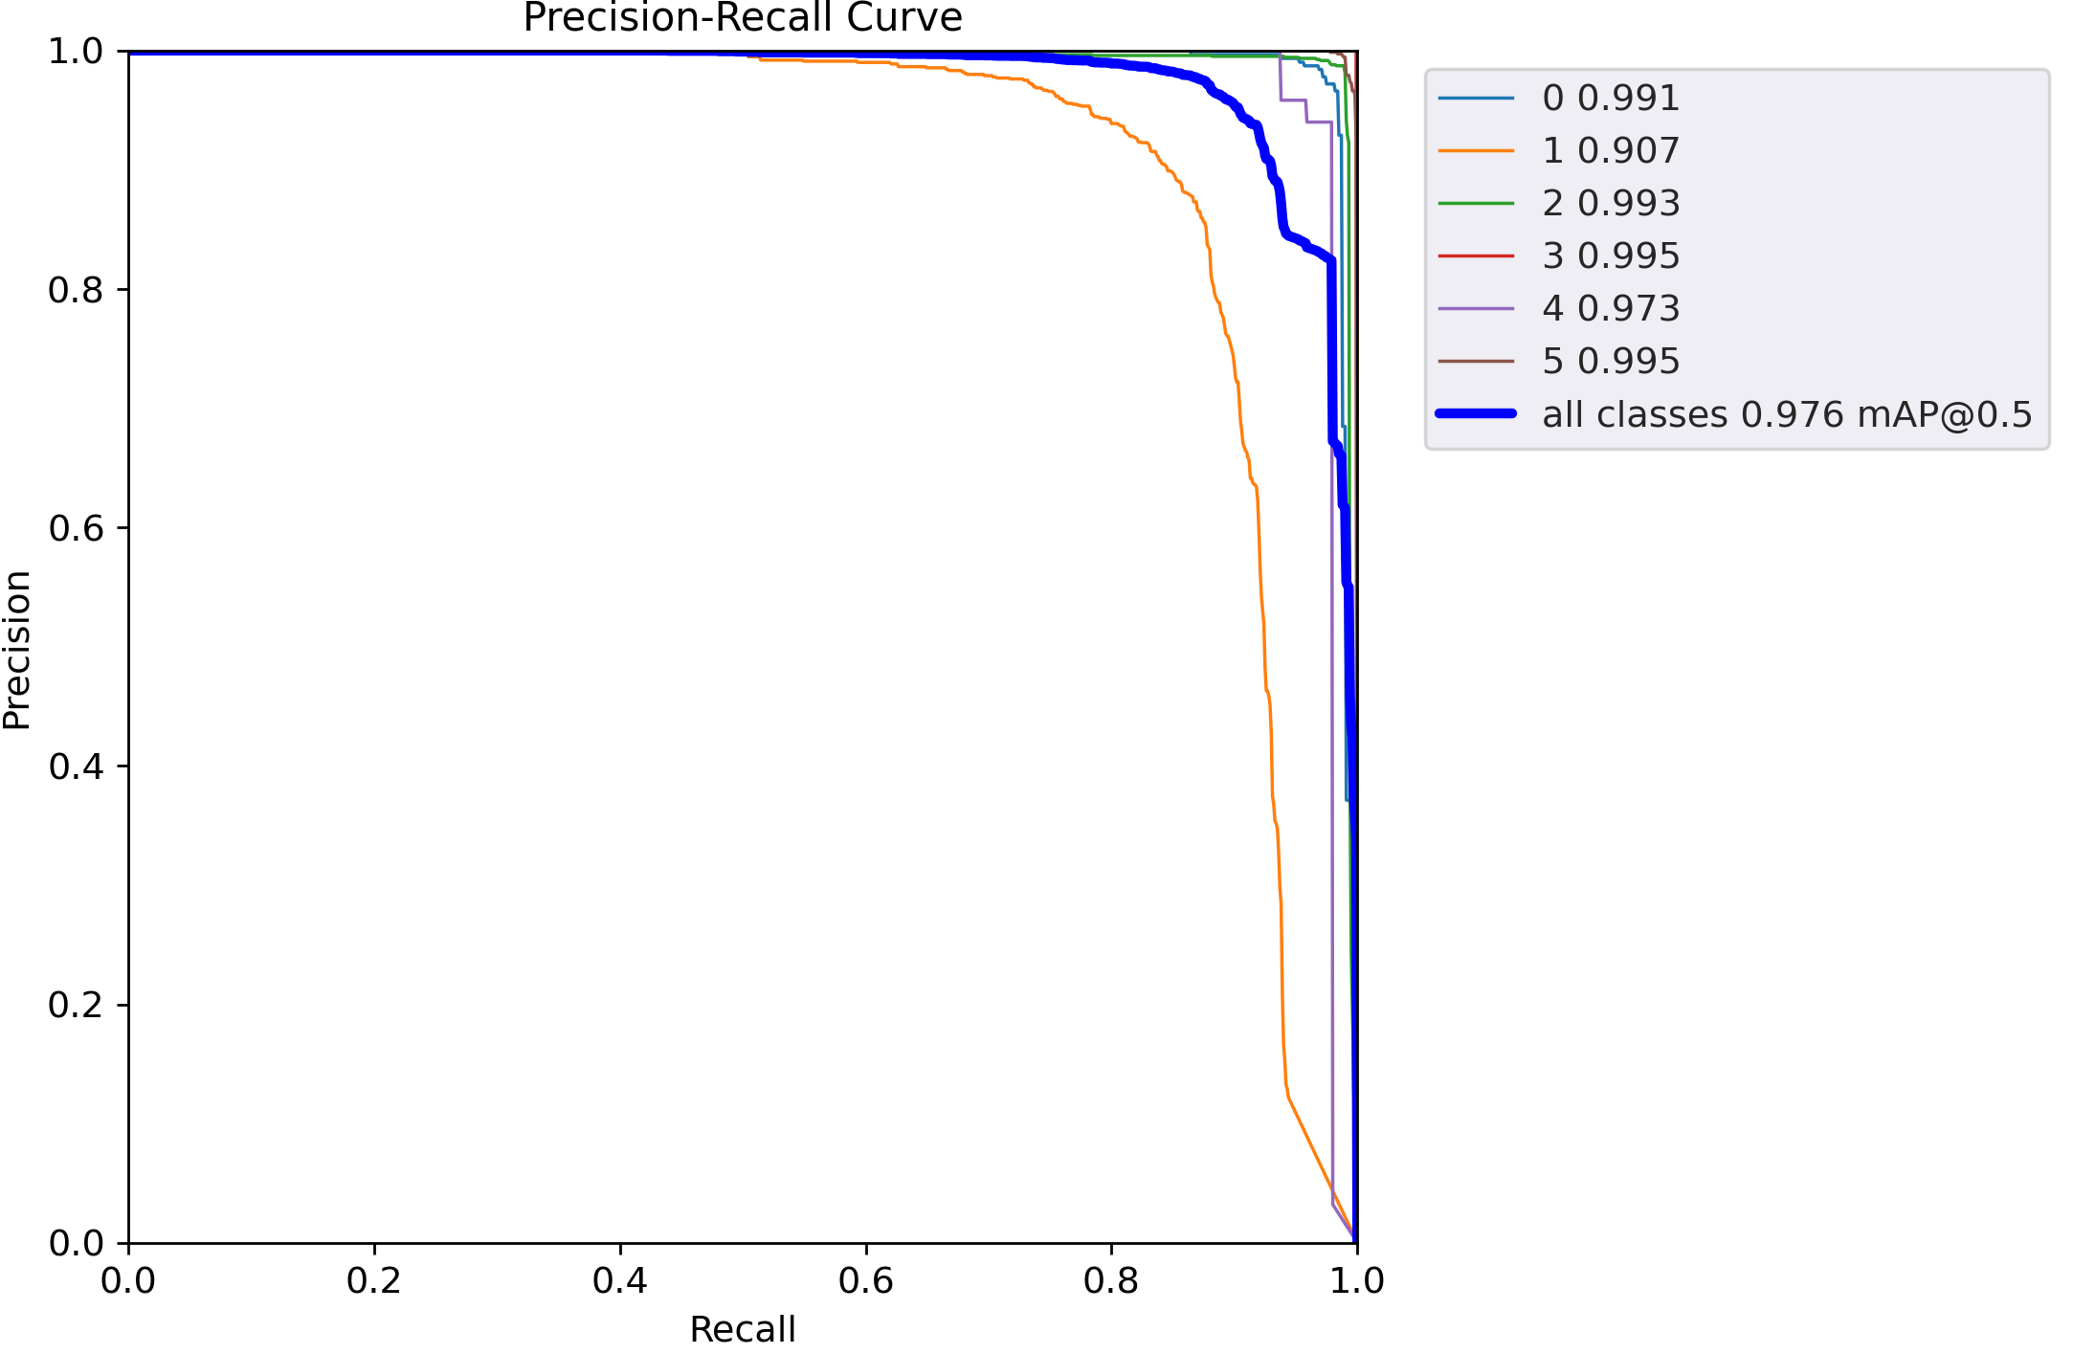
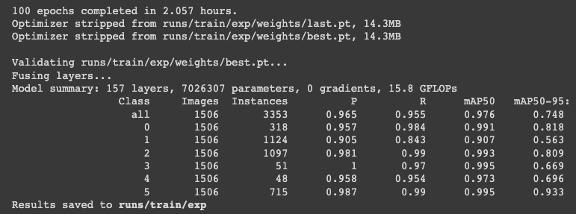
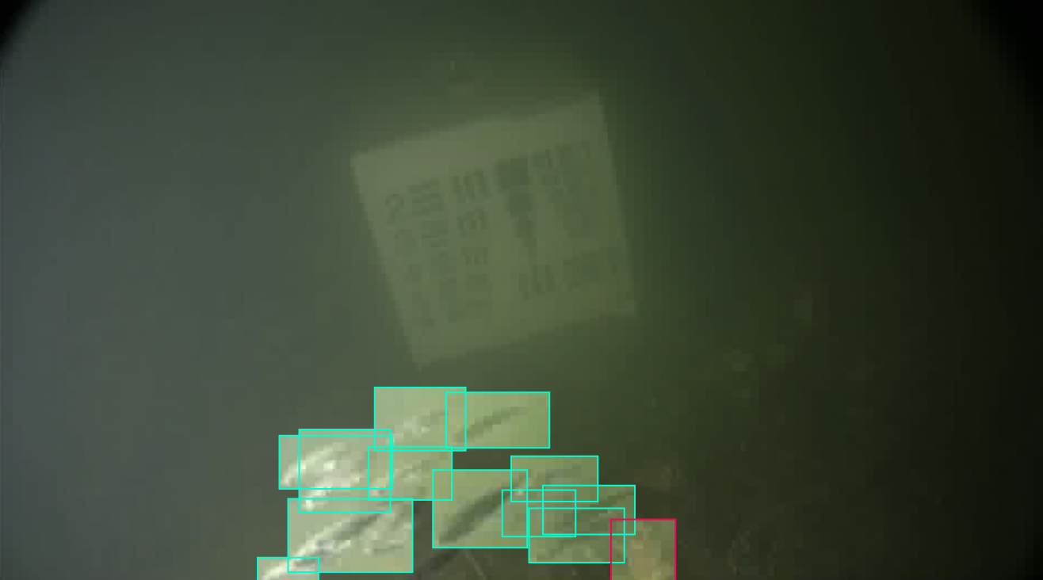
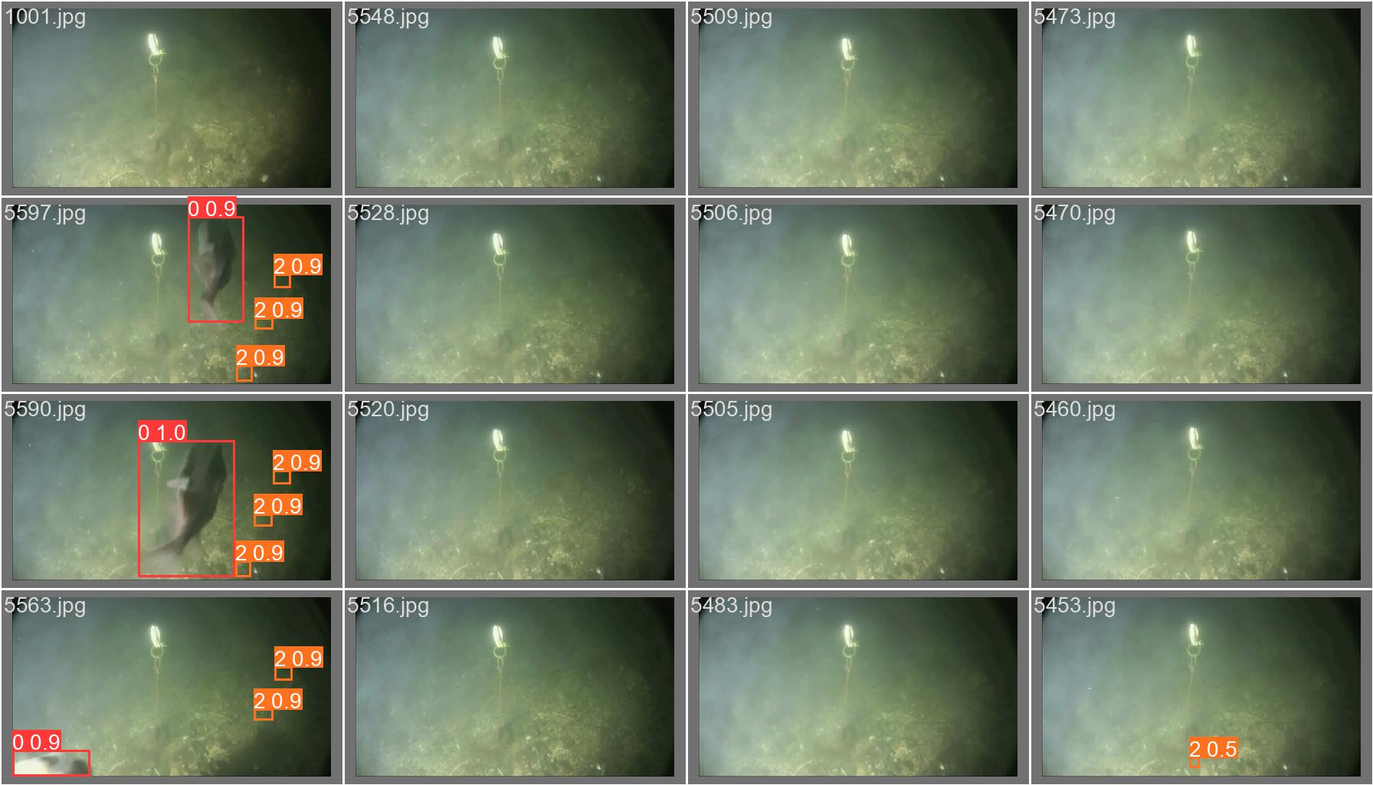
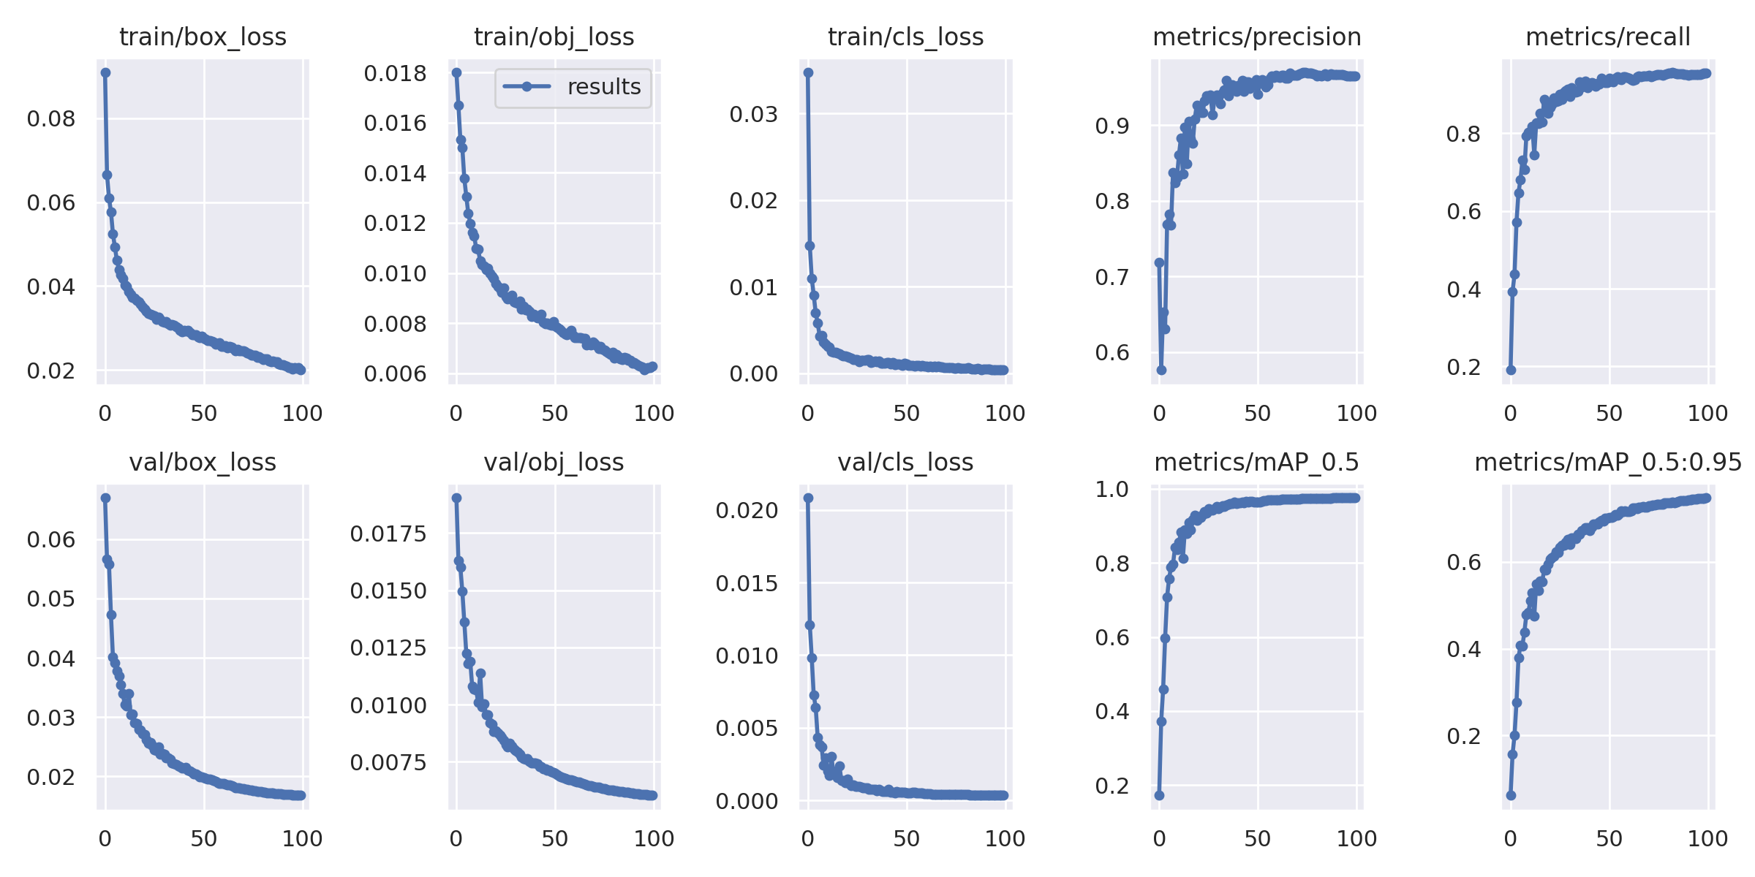
Part C.1.3: The System of my own implementation (For YOLO, EffDet and Detectron2)
Data
Train
Infer
Original video (filmed in Limfjorden)
!echo "train: images/train" >> data.yaml
!echo "val: images/val" >> data.yaml
!echo "test: images/test" >> data.yaml
https://www.kaggle.com/datasets/aalborguniversity/brackish-dataset
!python detect.py
--weights best.pt
--img 416
--conf 0.4
--source images/test
os.system('ffmpeg -i /content/videos/{}.avi -vf scale=960:540 -sws_flags bicubic {}-%04d.jpg -hide_banner'.format(filename,filename))
!python train.py
--img 416 \
--batch 16 \
--epochs 100 \
Frames
Cmatrix
PR Curve
contents/
├─ annotations/
│ ├─ val/
│ ├─ train/
│ ├─ test/
├─ images/
│ ├─ train/
│ ├─ test/
│ ├─ val/
Annotated Dataset
Total 1508 (val)+ 1508 (test)+12067 (train)
fish - 0
small_fish - 1
crab - 2
shrimp - 3
jellyfish - 4
starfish - 5
Predictions

Slide 33
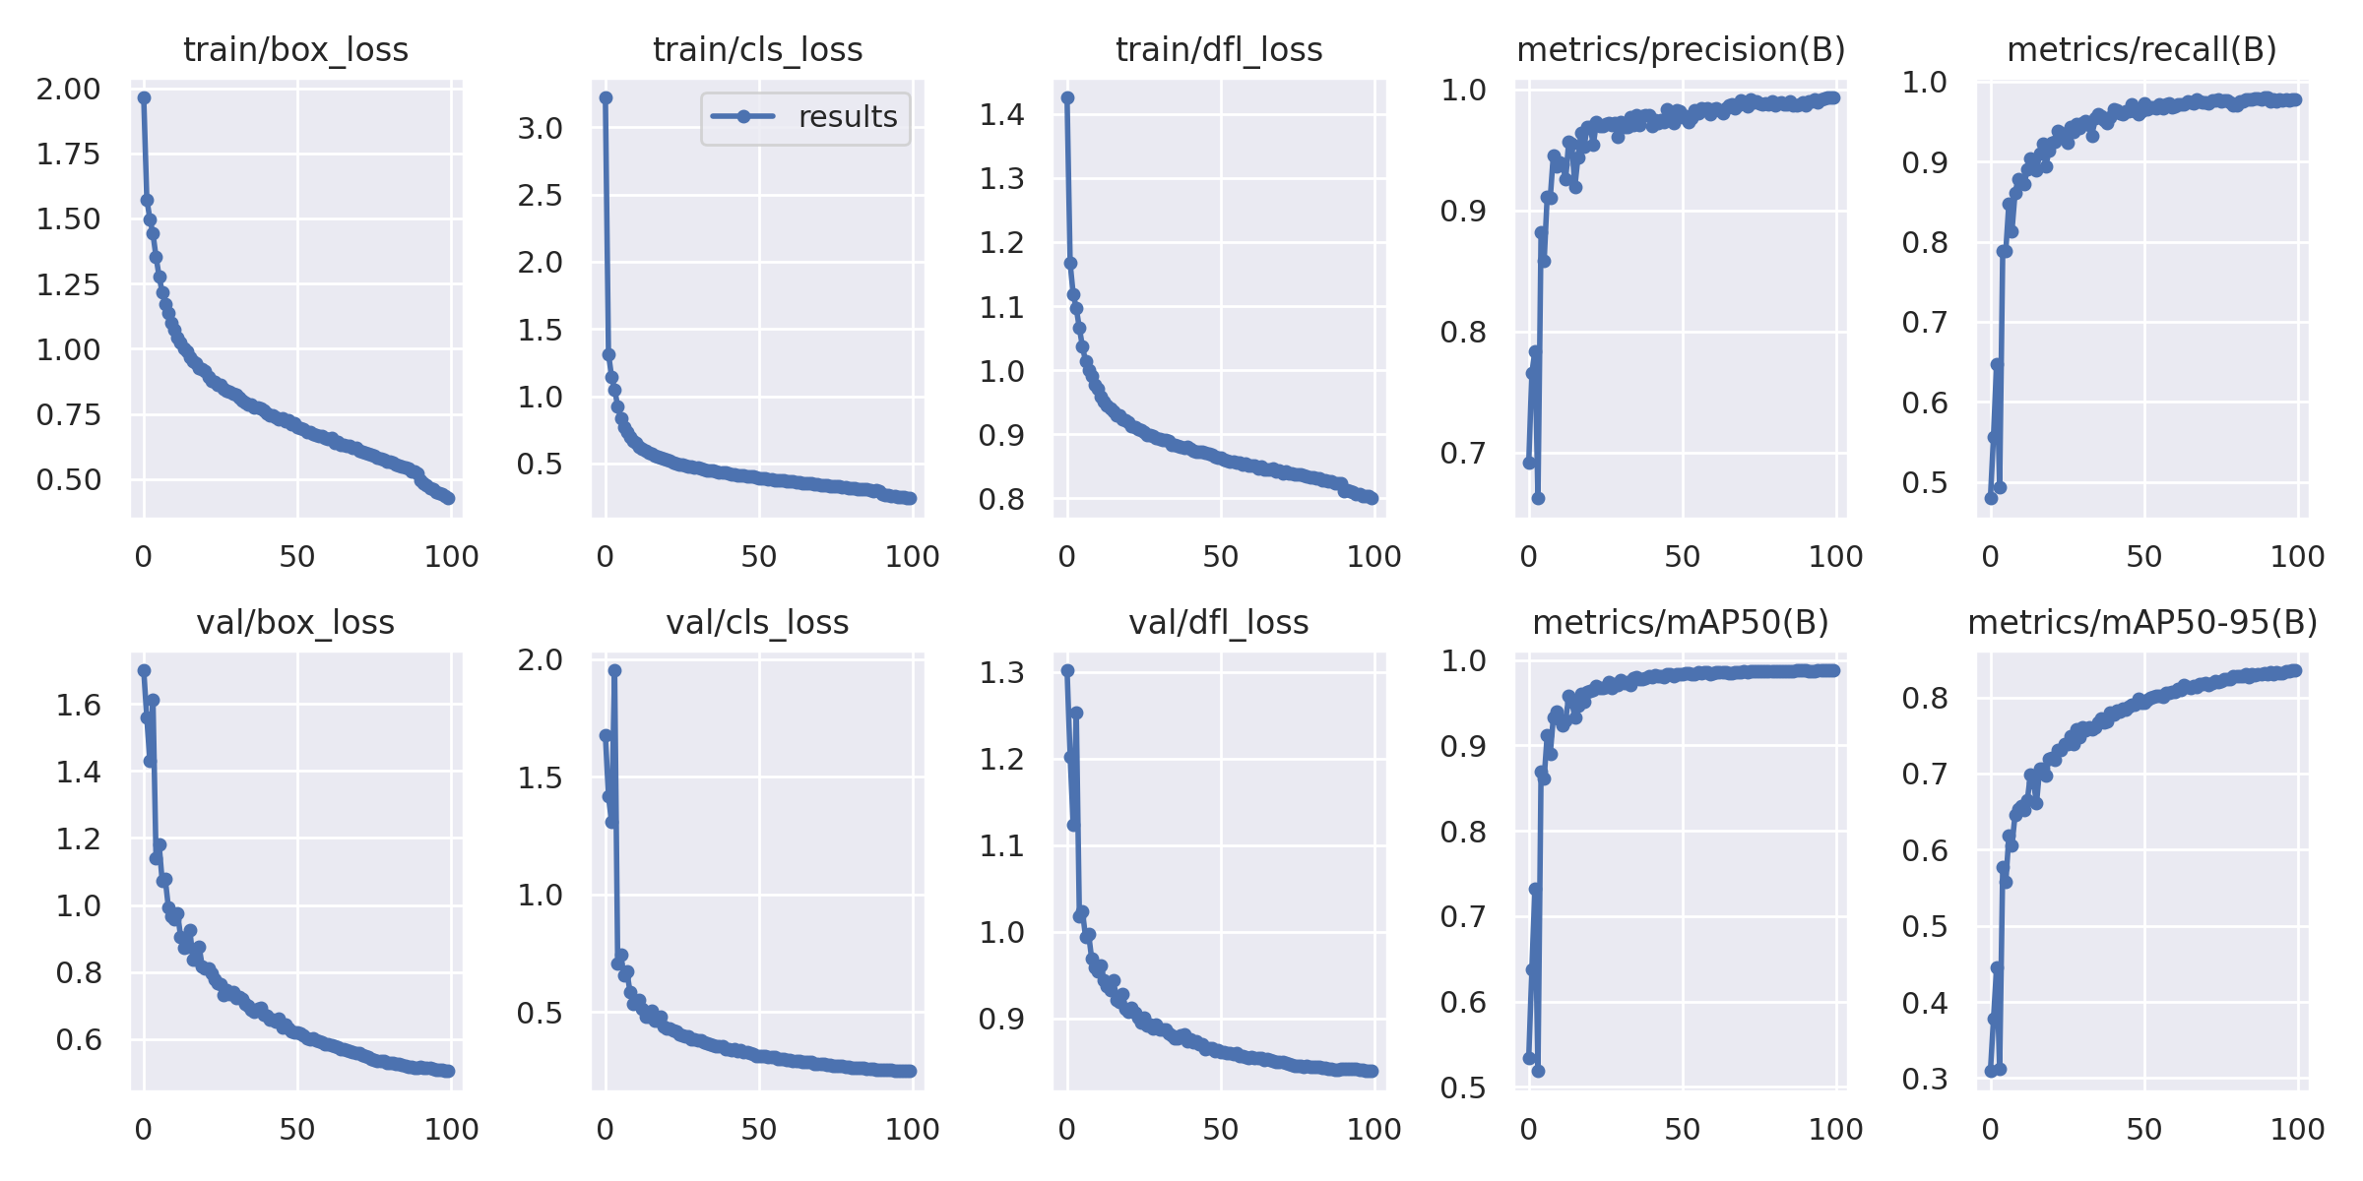
Part C.2.1: Results (YOLO vs EffDet) – Proposed Modified Algorithm
YOLOv8 for 100 Epochs (97.60mAP)
EfficientDet for 100 Epochs (98.70 mAP)

Slide 34
Miscellaneous (Feel free to ask)
Google Colab Demo / If you want to test the model online!
Roboflow annotation tool
Dataset space / mostly localized object map (from roboflow)
Model is hosted here – https://bit.ly/deepseanet
sanyamj@hiof.no
Precision is the proportion of true positive predictions among all positive predictions, while recall is the proportion of true positive predictions among all actual positive instances. mAP considers the precision and recall at different thresholds and calculates the average precision across all thresholds.

Slide 35
Thank You! Questions? References:
[1] Girshick, R., Donahue, J., Darrell, T., & Malik, J. (2014). Rich feature hierarchies for accurate object detection and semantic segmentation. In Proceedings of the IEEE conference on computer vision and pattern recognition (pp. 580-587).
[2] Tan, M., Pang, R., & Le, Q. V. (2020). Efficientdet: Scalable and efficient object detection. In Proceedings of the IEEE/CVF conference on computer vision and pattern recognition (pp. 10781-10790).
[3] Pedersen, M., Bruslund Haurum, J., Gade, R., & Moeslund, T. B. (2019). Detection of marine animals in a new underwater dataset with varying visibility. In Proceedings of the IEEE/CVF Conference on Computer Vision and Pattern Recognition Workshops (pp. 18-26).

